Slide 1

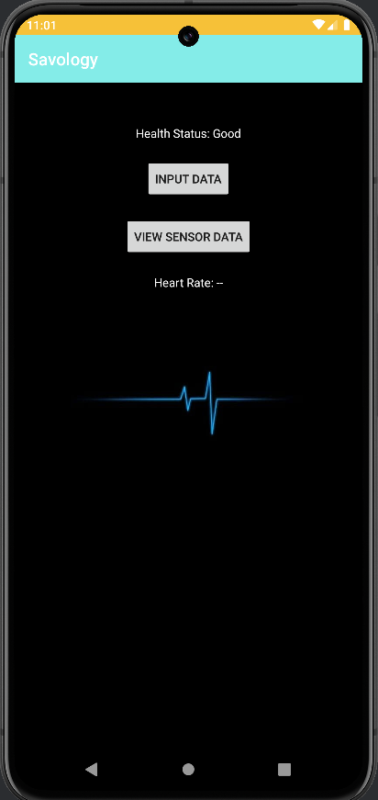
MOBILE APP
DEVELOPMENT
App Name: Savology
MODULE CODE: CIS4034-N
STUDENT NAME:
STUDENT ID:

Slide 2

INTRODUCTION AND TARGET AUDIENCE
  The mobile app that is to be developed is the health tracking application
  The targeted audience will be people between the age group of 40 to 60
  The targeted audience chosen due to the rising and advanced age of any diseases in an individual.
  The mHealth app development is crucial for improving the well-being of the elderly people.
  The mHealth app is to help aged people in receiving health regarding recommendations.

Slide 3
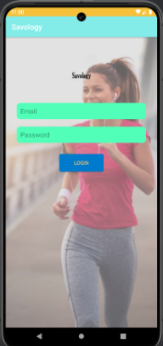
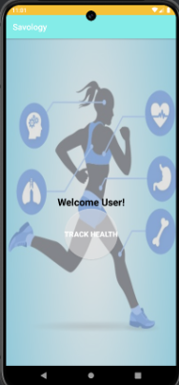
APP IDEA
  Health apps are known to be the software programs on mobile devices generating health-related information.
  The application will be entirely based on tracking the changes within the human body
  The application is to provide information related to health regarding diet, physical activity, and the use of medications.
  The mobile application would also provide the charts and graphs about the trends of the diseases
  The clear layout of the application will contain reminders, settings, and track health along with unique screens
Notes:
Now, I have moved on to the next slide in describing the idea about the development of the health tracking application. Health apps are known to be the software programs on mobile devices that generate health-related information for the people (Maaß et al., 2022). The application will be entirely based on tracking the changes within the human body at regular intervals of time in order to maintain the health along with avoiding any serious health issues. Besides this, the application is to provide information related to health regarding diet, physical activity, and the use of medications. Alongside, the mobile application would also provide the charts and graphs about the trends of the diseases within populations along with the recommendations for improving the individual health. In addition to this, the app is designed in a manner that patients are comfortable with the voice commands, screen readers and other features. The clear layout of the application to be provided including reminders, settings, and track health along with unique screens comprising details of verification page, and login page.

Slide 4
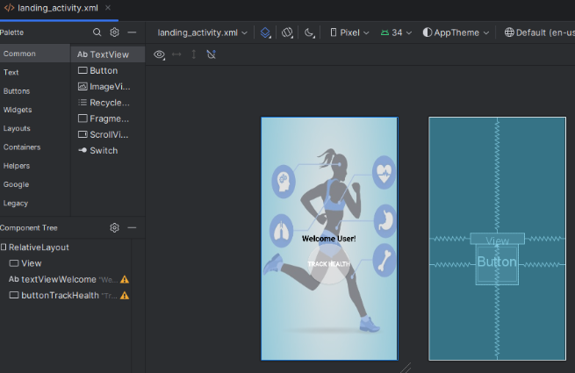
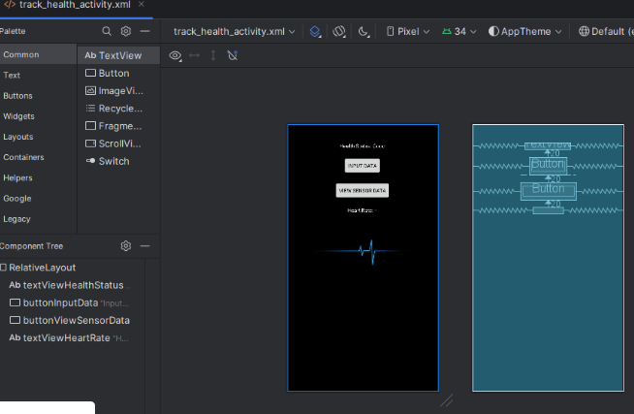
WORKING PROTOTYPE AND SOFTWARE DESIGN
  The open-source UI software development kit Kotlin DSL is considered for building Saveology
  The working prototype to be based on Android programming for Savology
  Android programming is to be integrated in the various application pages like landing, login, and detail verifications
  The design principles of the software are mainly based on simplicity, accessibility, and clarity
  The designing of the software is to be done in a manner that the application continues to develop according to the input from users
  Based on the client feedback and assistance, the prototype to be iterated to improve the user experience
Notes:
Here, in this slide, I am going to discuss the software design and the working prototype of the application. The open-source UI software development kit Kotlin DSL that is created by Google, is considered as the primary digital environment used for building compiled applications for mobile (Kotlin DSL, 2019). The working prototype to be based on Android programming that is to be integrated in the various application pages like landing, login, and detail verifications in order to make it accessible for the aged people. The design principles of the software are mainly based on simplicity, accessibility, and clarity to accommodate a greater number of users. Moreover, the designing of the software is to be done in a manner that the application Savology continues to develop according to the input from users and provide regular updates for the individuals. Based on the client feedback and assistance, the prototype to be iterated for improving the user experience. Besides this, the Savology app is to be linked to a GPS receiver to identify the current location of the users.

Slide 5
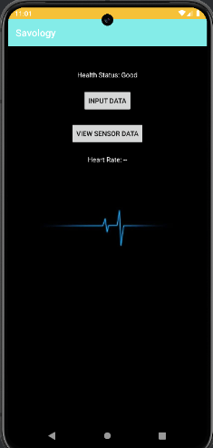
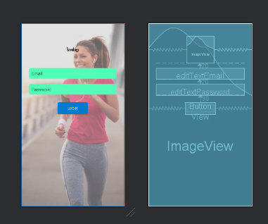
LOGIN AND HOME SCREEN
  The login page of Savology app contains the options of Email and Password, ensuring the users to get direct access to the application.
  home screen of the Savology app welcomes the user and makes it interesting for the users in tracking their health
  The login page appears to be quite simple and is easy to use, and the track health option provides access to the users.
  The "INPUT DATA" option enables the individuals to enter health-related data into the app
  The "VIEW SENSOR DATA" option displays the data being gathered from fitness tracker watches or smartwatch.
Notes:
Now, in this slide, I am going to provide the discussions based on the login and the home screen. The login page of Savology app contains the options of Email and Password, ensuring the users to get direct access to the application. The home screen of the Savology app welcomes the user and makes it interesting for the users in tracking their health through the option `TRACK HEALTH”. The login page appears to be quite simple and is easy to use, and the track health option provides access to the users in keeping track of their health status particularly, the heart rate, blood pressure and weight. The "INPUT DATA" option enables the individuals to enter health-related data into the app and the "VIEW SENSOR DATA" option displays the data being gathered from fitness tracker watches or smartwatch.

Slide 6
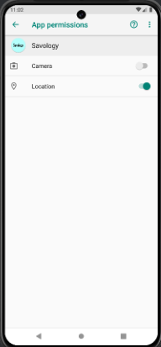
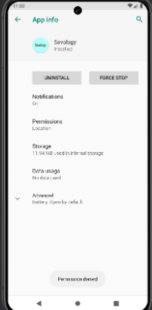
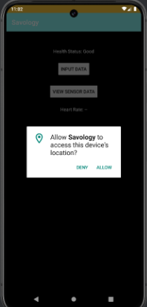
CONNECTION WITH DEVICE PAGES
  The devices pages are connected to the GPS in making it allow for the application to access the location of the device.
  The Savology app is linked to a GPS receiver to identify the in terms of determining the current location.
  The built-in GPS and other sensors track the physical activity of the users, sleeping patterns, and the air quality
  The permissions to be accepted for running the app in accessing the exact location of the user.
Notes:
In this current slide, I am to discuss the connection made with the pages of the mobile application or the device. The devices pages are connected to the GPS in making it allow for the application to access the location of the device. The Savology app is linked to a GPS receiver to identify the in terms of determining the current location of the individuals and accordingly track their movements, heart beat and utilised levels of energy. The built-in GPS and other sensors track the physical activity of the users, sleeping patterns, and also measures the air quality (Emish et al., 2023). Besides this, the permissions to be accepted for running the app in accessing the exact location of the user.

Slide 7
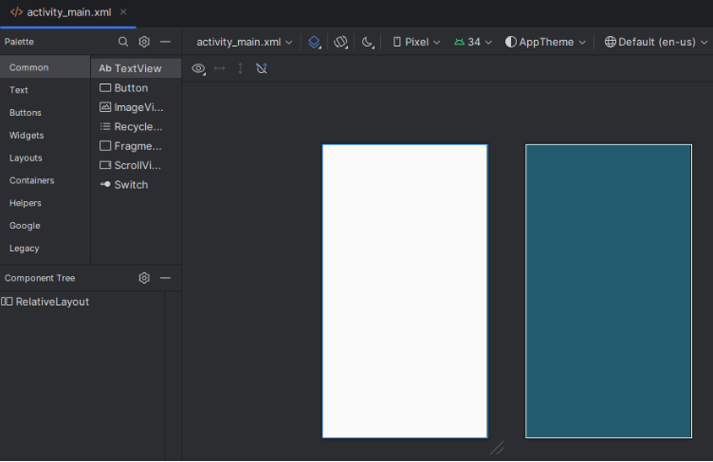
JUSTIFICATION FOR
SOFTWARE DESIGN DECISIONS
  Design & Layout: Savolgy would have a simple and easily accessible design for senior people.
  User Experience: Savology has prioritised customer feedback and support and it has provided users with fast customer care channels
  Usage of Third-Party Libraries: Materials, features, functionality and third-party software have been utilised as third-party libraries
  Data Persistence: Firebase has been used as a cloud platform for better integrity and storage capacity.
Figure: Main activity
Notes:
The present slide has discussed the decisions for the design of the software that has been used in Savology in terms of layout, user experience, data performance and third party library usage. In order to provide a smooth user experience, the design of the app is simple and easily accessible for senior people. Accessibility, clarity, and simplicity are given top priority in the design concepts to cater to a diverse spectrum of users with varying levels of technical proficiency and health consciousness. In addition, Savology has prioritised customer feedback and support and it has provided users with fast customer care channels for addressing questions, fixing technical issues, and offering guidance on ways to use the app. In order to store the information, Firebase has been used as a cloud platform for better integrity and storage capacity. Moreover, materials, features, functionality and third-party software have been utilised as third-party libraries in Savology.

Slide 8
SOCIAL, LEGAL, ETHICAL
AND SECURITY ISSUES
  Social Issues: Elderly people may struggle to operate the app in terms of layout and usability issues (Awan et al., 2021). Socially, for users between the ages of 40 and 60, the app encourages illness prevention and health knowledge.
  Legal Issues: Infringement and breaching of informed consent regulation could occur due to non-adherence to legal requirements (Pallocci et al., 2023). Savology places a high priority on user privacy and data security in order to foster adoption and foster confidence.
  Ethical Issues: The General Data Privacy Regulation (GDPR) needs to be followed while developing the app because developing software solutions that can protect privacy is ensured by following these rules (Alhazmi and Arachchilage, 2021). In addition, getting informed permission, maintaining data confidentiality, and protecting against illegal access are a few ethical factors (Pallocci et al., 2023).
  Security Issues: Authorisation, authentication and upgrading software components regularly are necessary to prevent attacks (Shukla et al., 2022). Sensitive user data is protected through the use of strong security mechanisms including encryption and secure authentication (Weippl and Schrittwieser, 2023).
Notes:
Social, legal, ethical and security issues of Savolgy have been elevated in this particular slide. Elderly people may struggle to operate the app in terms of layout and usability issues (Awan et al., 2021). Considering the licence requirements of third-party libraries and the Android platform is crucial. In this regard, infringement and breaching of informed consent regulation could occur due to non-adherence to these legal requirements (Pallocci et al., 2023). Furthermore, the app has the possibility to collect sensitive information from users as it works as a health-tracking tool for old people. In this case, the General Data Privacy Regulation (GDPR) needs to be followed while developing the app because developing software solutions that can protect privacy is ensured by following these rules (Alhazmi and Arachchilage, 2021). Additionally, in order to prevent malicious attacks, authorisation, authentication, host verification and upgrading software components regularly are necessary (Shukla et al., 2022).

Slide 9
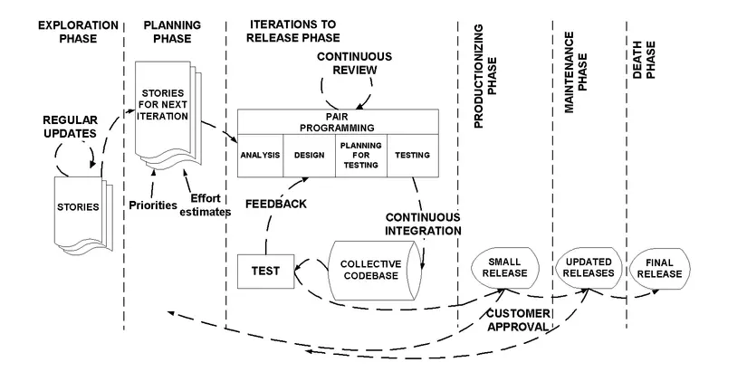
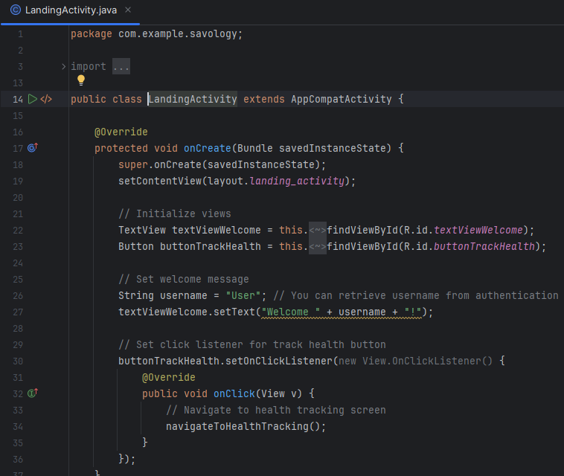
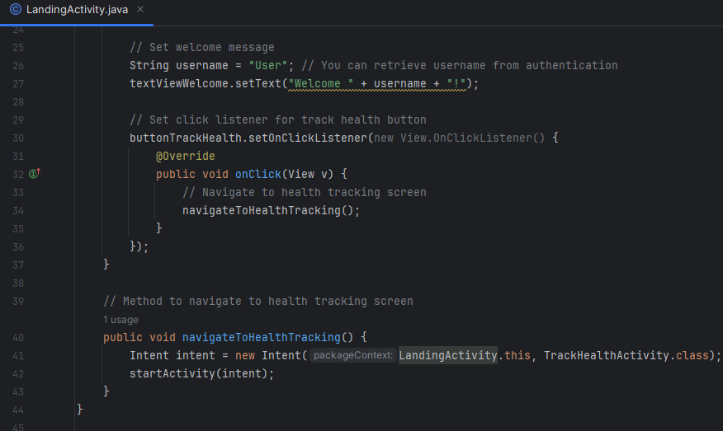
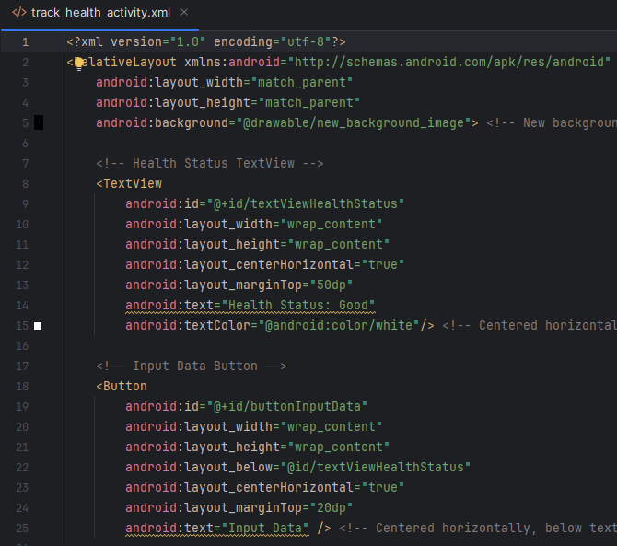
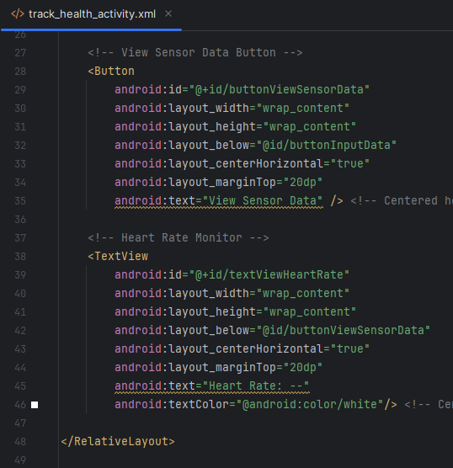
AGILE DEVELOPMENT METHOD
  Justification for Agile methodology: Agile systems prioritise software functionality over detailed documentation, with an emphasis on the users interacting with the system (Ríos and Souto, 2019).
  Planning process: Extreme Programming (XP) has been used as an agile development method that ensures a high-quality project and provides a flexible approach to possible chnages (Shrivastava et al., 2021).
  Management process: Continuous feedback from earlier works helps identify areas of improvement.
  Development process: Metrics including defect rate, cycle time, and velocity are tracked in order to assess productivity and quality.
Figure: Extreme Programming (XP)
(Source: Ibrahim et al., 2020)
Figure: Programme Code for Operations of Landing Page
Figure: Programme Code for Layout of Health Checking Activity of Savology
Notes:
In this current slide, I am going to describe the agile development method that has been used in order to develop Savology. Agile systems prioritise software functionality over detailed documentation, with an emphasis on the users interacting with the system (Ríos and Souto, 2019). In order to develop and assess the app, Extreme Programming (XP) has been used as an agile development method. XP is an effective agile method for software development that ensures a high-quality project and provides a flexible approach to possible chnages (Shrivastava et al., 2021). Moreover, the aforementioned method can discover the areas of improvement and simplify the design with continuous feedback from earlier works. Metrics including defect rate, cycle time, and velocity are tracked in order to assess productivity and quality.

Slide 10
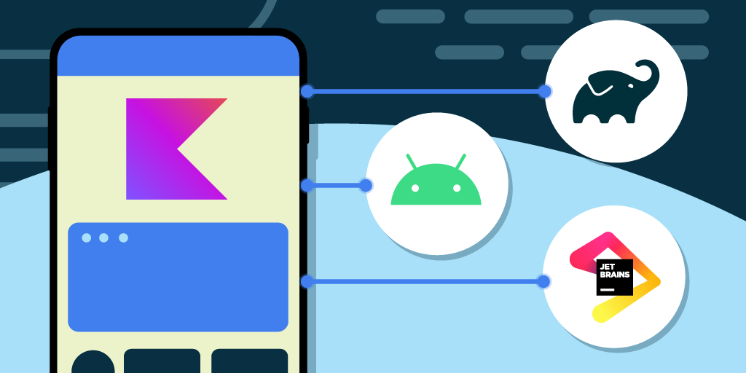
USE OF DIGITAL ENVIRONMENTS
AND TOOLS
  Kotlin DSL has been used as the main digital environment that cuts down on development time and effort while ensuring consistency and uniformity across many devices (Kotlin DSL, 2024).
  The tool removes constraints on native capabilities imposed by the framework (Boukhary and Colmenares, 2019).
  The usage of Kotlin DSL makes it possible to develop a reliable, feature-rich, and user-friendly mobile application for Savology.
Notes:
The present slide has discussed the implementation of digital tools and environments for the development of Savolgy. In this regard, One of the main digital environments used for this project is the open-source UI software development kit Kotlin DSL, developed by Google. Kotlin DSL enables developers to create code once and publish it across multiple platforms, including iOS and Android, that cuts down on development time and effort while ensuring consistency and uniformity across many devices (Kotlin DSL, 2024). In this regard, null safety and extension functions, two contemporary language features of Kotlin, improve code quality and lower runtime errors to guarantee a stable and dependable program (Wood et al., 2020). The development process is streamlined by its robust interaction with Android Studio and smooth compatibility with Java. Additionally, the expressiveness and simple syntax of Kotlin DSL increase developer productivity and code maintainability (Wood et al., 2020). All of these characteristics combine to make Kotlin DSL the perfect framework for creating an excellent, safe, and intuitive application, similar to Savology. In this way, Savolgy can maximise its impact. In addition to this, the tool removes constraints on native capabilities imposed by the framework and enables developers to create native code for iOS and Android (Boukhary and Colmenares, 2019). Effective utilisation of digital environments and technologies, especially Kotlin DSL, makes it possible to develop a reliable, feature-rich, and user-friendly mobile application for Savology.

Slide 11
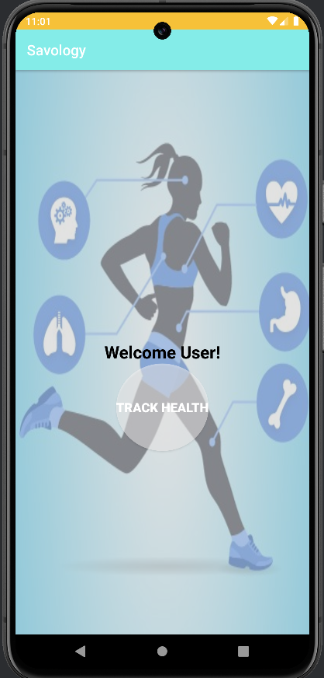
CONCLUSION
  Savology is a tracking software that can track changes in the human body to prevent serious health issues.
  The target audience for the app age group of 40 to 60 as they are vulnerable to diseases.
  Firebase as a cloud platform and Extreme Programming (XP) have been used for the development of the app.
Notes:
The overall summary of the presentation has been discussed in this slide. Based on this, it can be concluded that Savology is a tracking software that can track changes in the human body to prevent serious health issues. The target audience for the app age group of 40 to 60 as they are vulnerable to diseases. The interface and design of Savology are simple and easy to access for senior people. The app has used Firebase as a cloud platform for better integrity and storage capacity. Extreme Programming (XP) has been employed to ensure the superior quality of a project. Kotlin DSL has been used as the main digital environment that cuts down on development time

Slide 12
REFERENCES
Alhazmi, A. and Arachchilage, N. A. G. (2021) ‘I’m all ears! Listening to software developers on putting GDPR principles into software development practice’, Personal and Ubiquitous Computing. doi: https://doi.org/10.1007/s00779-021-01544-1.
Awan, M. et al. (2021) ‘Usability Barriers for Elderly Users in Smartphone App Usage: An Analytical Hierarchical Process-Based Prioritization’, Scientific Programming, 2021, p. e2780257. doi: https://doi.org/10.1155/2021/2780257.
Boukhary, S. and Colmenares, E. (2019) A Clean Approach to Kotlin DSL Development through the Kotlin DSL Clean Architecture Package, IEEE Xplore. doi: https://doi.org/10.1109/CSCI49370.2019.00211.
Emish, M. et al. (2023) ‘A Mobile Health Application Using Geolocation for Behavioral Activity Tracking’, Sensors, 23(18), pp. 7917–7917. doi: https://doi.org/10.3390/s23187917.
Kotlin DSL (2019) Kotlin DSL - Beautiful native apps in record time, Kotlin DSL.dev. Available at: https://Kotlin DSL.dev/ (Accessed: 1 May 2024).
Kotlin DSL (2024) Multi-Platform, Kotlin DSL.dev. Available at: https://Kotlin DSL.dev/multi-platform (Accessed: 1 May 2024).
Ibrahim, M. et al. (2020) ‘Presenting and Evaluating Scaled Extreme Programming Process Model’, International Journal of Advanced Computer Science and Applications, 11(11). doi: https://doi.org/10.14569/ijacsa.2020.0111121.
Maaß, L. et al. (2022) ‘The Definitions of Health Apps and Medical Apps From the Perspective of Public Health and Law: Qualitative Analysis of an Interdisciplinary Literature Overview’, JMIR mHealth and uHealth, 10(10), p. e37980. doi: https://doi.org/10.2196/37980.
Pallocci, M. et al. (2023) ‘Informed Consent: Legal Obligation or Cornerstone of the Care Relationship?’, International Journal of Environmental Research and Public Health, 20(3), p. 2118. doi: https://doi.org/10.3390/ijerph20032118.
Ríos, J. M. and Souto, N. P. - (2019) ‘Approach of Agile Methodologies in the Development of Web-Based Software’, Information, 10(10), p. 314. doi: https://doi.org/10.3390/info10100314.
Shrivastava, A. et al. (2021) ‘A Systematic Review on Extreme Programming’, Journal of Physics: Conference Series, 1969(1), p. 012046. doi: https://doi.org/10.1088/1742-6596/1969/1/012046.
Shukla, A. et al. (2022) ‘System security assurance: A systematic literature review’, Computer Science Review, 45, p. 100496. doi: https://doi.org/10.1016/j.cosrev.2022.100496.
Weippl, E. and Schrittwieser, S. (2023) ‘Introduction to Security and Privacy’, springer, pp. 397–414. doi: https://doi.org/10.1007/978-3-031-45304-5_26.
Wood, B. et al. (2020) ‘Remote Method Delegation: a Platform for Grid Computing’, Journal of Grid Computing, 18(4), pp. 711–725. doi: https://doi.org/10.1007/s10723-020-09525-z.

Slide 13
THANK
YOU!

